Slide 1
DATASET OVERVIEW
The dataset represents a structured form of customer information for the bank, including a combination of demographic fields (Gender, Nationality, Occupation, Branch ID) and financial fields (Estimated Income, Bank Deposits, Savings, Fixed Deposits, Superannuation). A first glimpse at the dataset reveals a clear definition of the data type and a low level of missing values.

Slide 2
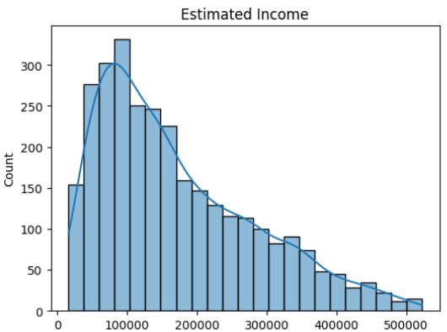
Univariate Analysis
Findings:-
Estimated Income shows a right-skewed distribution, with most customers earning in the low-to-middle income range.
A small proportion of customers fall into the high-income category, indicating income inequality within the customer base.
Income Distribution

Slide 3
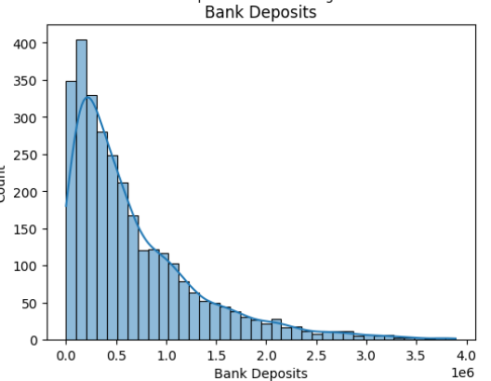
Univariate Analysis
Findings:-
Bank Deposits exhibit heavy right skewness.
The majority of customers maintain moderate deposit balances, while a small group holds significantly high deposits.
Bank Deposits

Slide 4
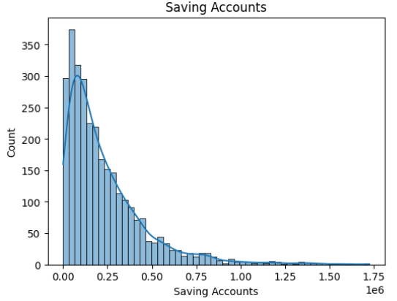
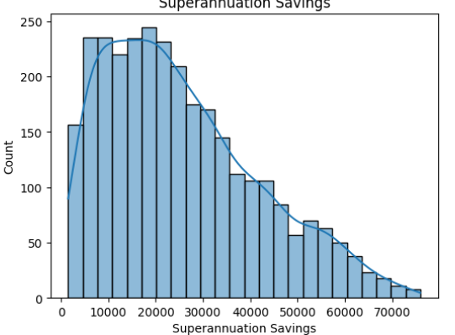
Univariate Analysis
Findings:-
All investment-related variables follow a similar pattern:
1. High concentration at lower values.
2. Long tail of high-value customers.
This reflects typical customer behavior in retail banking.
Savings And Superannuation

Slide 5
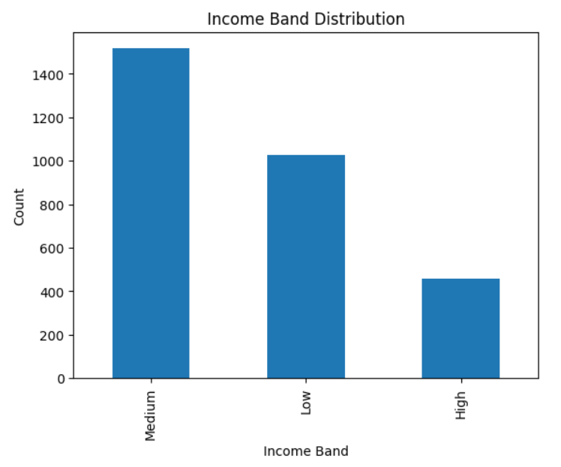
Univariate Analysis
Findings:-
Customers are primarily distributed across Low- and Middle-Income Bands.
High Income customers are fewer but financially significant.
Income Band Segmentation

Slide 6
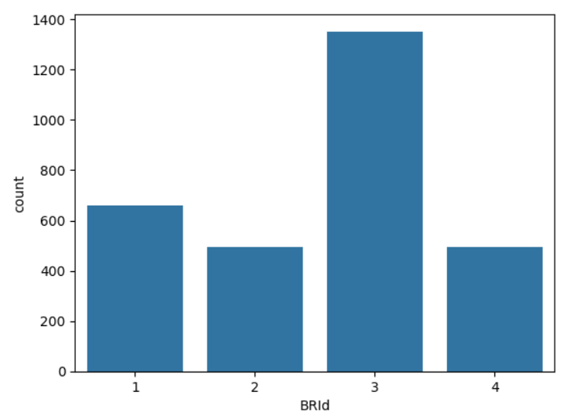
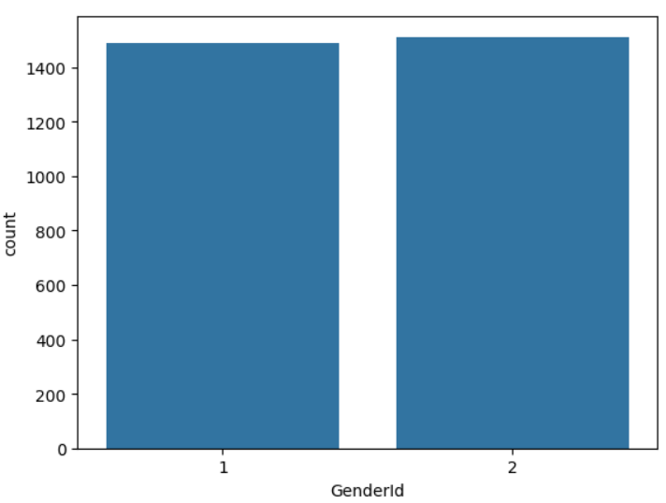
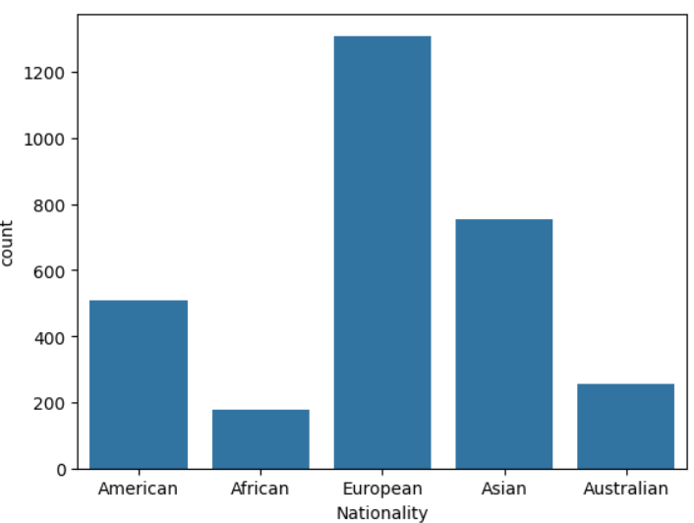
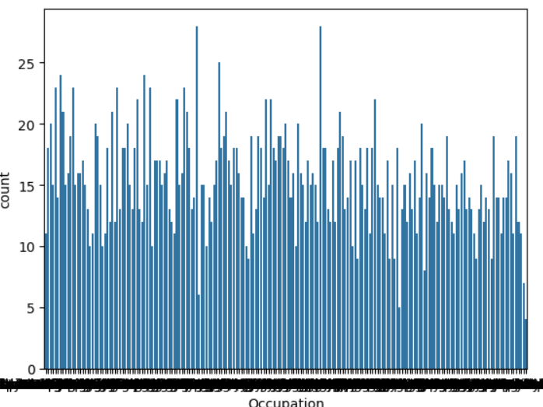
Univariate Analysis
Findings:-
Uneven customer distribution across branches, suggesting varying regional performance.
Noticeable imbalance, which may influence product targeting strategies.
A few nationalities represent the majority of customers.
Categorical Variable Distribution

Slide 7
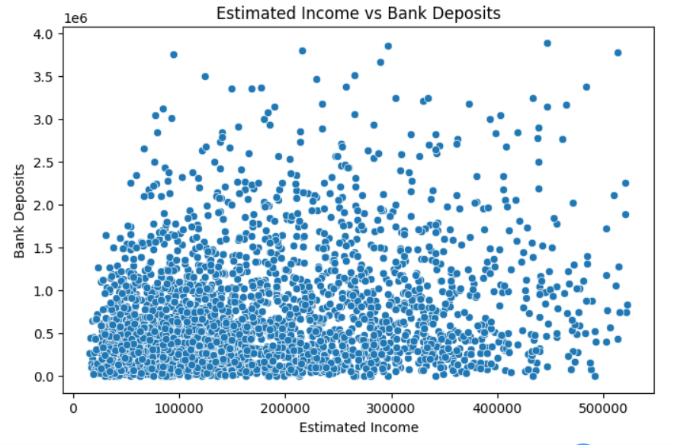
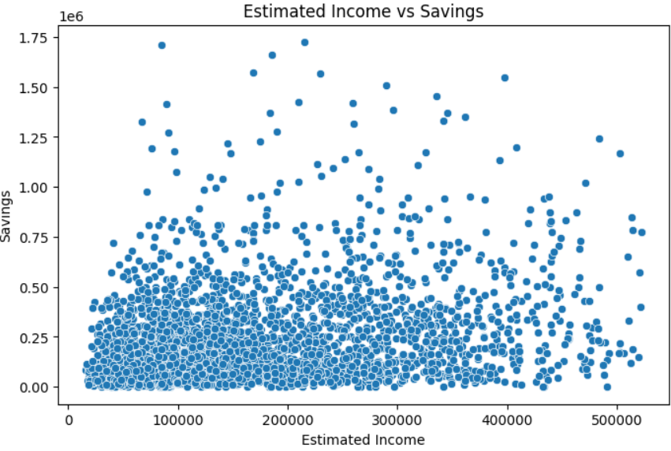
Bivariate Analysis
Findings:-
Estimated Income shows a strong positive relationship with:
1.Bank Deposits
2.Savings Accounts
Higher-income customers tend to hold larger balances across multiple financial products.
Income VS Financial Assets

Slide 8
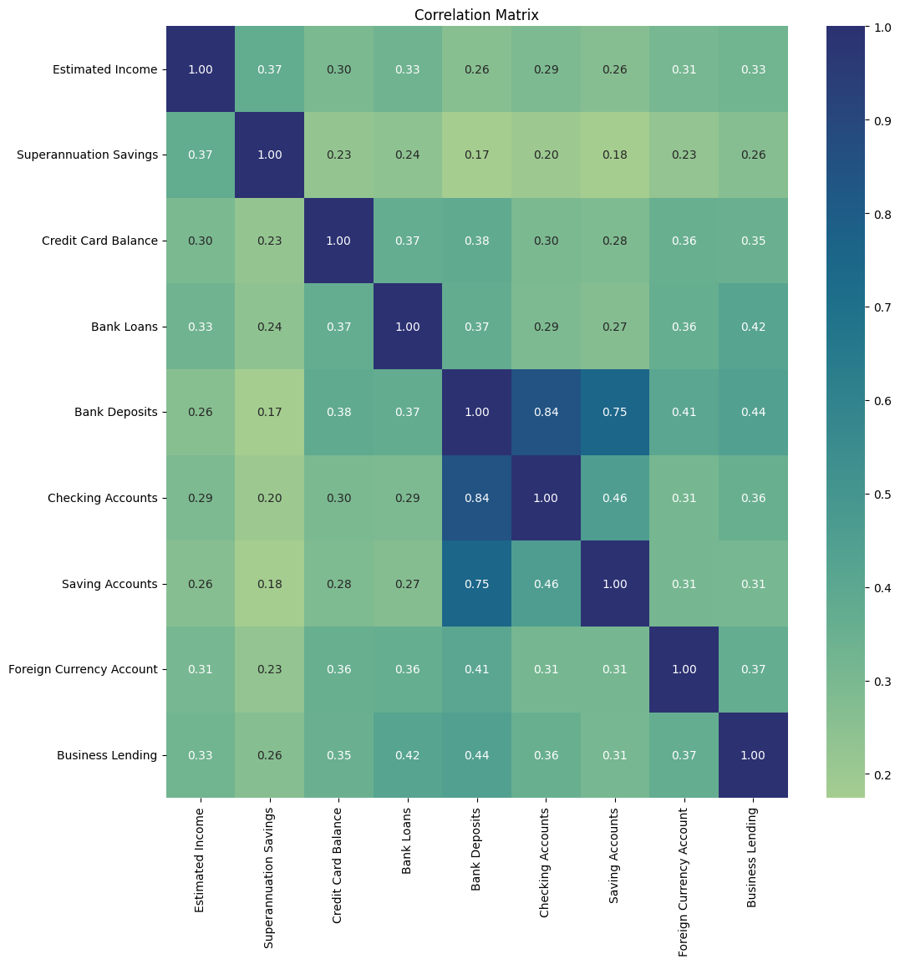
Bivariate Analysis
Findings:-
Strong correlations observed between:
1. Bank Deposits and Superannuation.
2. Savings and Fixed Deposits.
Customers with higher deposits tend to invest across multiple products rather than a single asset type.
Relationship Between Financial Products

Slide 9
Final Thoughts
Financial variables are highly skewed and require transformation before modeling.
Income is the primary driver of asset accumulation.
Customer wealth is concentrated among a small segment.
Strong inter-product relationships suggest opportunities for cross-selling and portfolio expansion.

Slide 10
-:THANK YOU:-

